Slide 1

Effective
Safety and Health
Programs

Slide 2
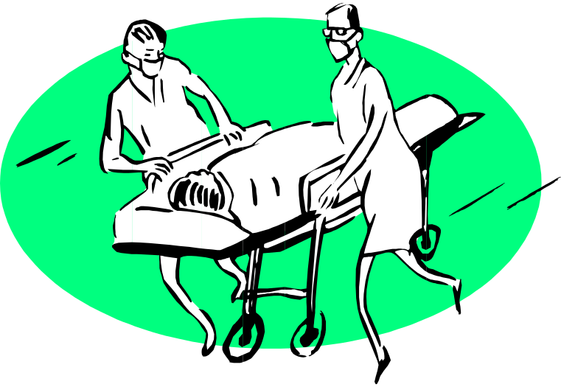
Costs of Accidents
Nearly 50 workers are injured every minute of the 40-hour work week
Almost 17 of these workers die each day
These injuries cost society $127.7 billion in 1997

Slide 3

Introduction
Research indicates benefits to companies who establish effective worker safety and health programs:
  Reduction in the extent and severity of work-related injuries and illnesses
  Improved employee morale
  Higher productivity
  Lower workers’ compensation costs

Slide 4

Introduction
An effective safety and health program makes all the difference in preventing injuries and illnesses in the workplace.
The result is lower accident-related costs.
Other benefits include:
  Reduced absenteeism,
  Lower turnover,
  Higher productivity, and
  Improved employee morale.
And it's the right thing to do.

Slide 5

Exemplary Workplaces
Common characteristics of effective safety and health programs:
  Assignment of responsibility to managers, supervisors, and workers
  Regular inspections to control hazards
  Employee training and orientation for the recognition and avoidance of hazards

Slide 6

S & H Program Guidelines
Systematic approach to hazard:
  Identification
  Evaluation
  Control
  Goes beyond specific requirements of the law to focus on all hazards

Slide 7

S & H Program Guidelines
As the size of the workplace increases so does the need for a formalized written program
Program effectiveness more important than “In Writing”
Element taken from the ‘Safety and Health Program Guidelines - 1989’
S & H
Program
Company
xyz

Slide 8

Integrated Approach to Health and Safety
The best Safety and Health Programs involve every level of the organization, instilling a safety culture that reduces accidents for workers and improves the bottom line for managers.
When Safety and Health are part of the organization and a way of life, everyone wins.
There are four crucial questions you should be asking.

Slide 9











Slide 10
S & H Return on Investment
Only about 30 percent of businesses have established safety and health programs.
About half of the 95 million workers who would be covered under an OSHA safety and health program standard don't have that protection today.
Studies have shown a $4 to $6 return for every dollar invested in safety and health.
h

Slide 11
Management System: Safety & Health Integration
To reduce accidents, injuries, illnesses, and their related costs, everyone must place as much emphasis on safety and health issues as they place on other core management issues, such as production, sales, and quality control.
To be most effective, safety and health must be balanced with, and incorporated into, the other core business processes.

Slide 12

Major Elements
Keys to an effective program:
  Management commitment and employee involvement
  Worksite analysis
  Hazard prevention and control
  Safety and health training
h

Slide 13

Management Commitment
Safety and health policy statement
Clear program goals and objectives
Visible involvement in program from top management
Leadership

Slide 14

Management Commitment
Assignment of safety and health responsibilities
Clear communication of program goals

Slide 15

Management Commitment
Provides adequate authority to responsible personnel
Holds managers, supervisors and employees accountable for meeting their responsibilities

Slide 16

Management Commitment & Employee Involvement
Complement one another
Management provides the motivating force and resources for safety and health programs
Employee involvement provides workers opportunities to develop and express their own commitment to the safety and health program

Slide 17

Employee Involvement
Active role for employees:
  Workplace inspections
  Hazard analysis
  Development of safe work rules
  Training of coworkers & new hires

Slide 18

Worksite Analysis
Hazard Identification:
  Facilities
  Processes
  Materials
  Equipment
Use professionals that understand the processes involved

Slide 19

Worksite Analysis
Perform job hazard analysis
  Break tasks down into elements
  Identify the hazards in each element
  Identify control measures and safe work rules for each element

Slide 20

Worksite Analysis
Identify existing hazards
Anticipate hazards where procedures or operations change

Slide 21

Worksite Analysis
Provide for regular site safety and health inspections
Method for reporting and correcting hazards:
  Communication of hazards
  Method for correcting reported hazards
  Prioritizing work
  Timeliness
  Without fear of reprisal

Slide 22

Worksite Analysis
Effective system for:
  Accident Investigations
  Near Misses
Identify root causes
Contributing factors
Methods for prevention of reoccurrence

Slide 23

Worksite Analysis
Analyze injury and illness trends over time:
  Identify injury type patterns
  Identify injury task patterns
  Analyze by department
Identify common causes and prevent reoccurrence

Slide 24

Hazard Prevention and Control
Determination made that hazard exists
Where feasible eliminate by job or task design/redesign
Elimination not feasible, control hazards
  Engineering controls
  Administrative controls
  Personal protective equipment (PPE)

Slide 25

Hazard Prevention and Control
System for timely correction or control of hazards
Safe work procedures:
  Developed from worksite analysis
  Training
  Correction of unsafe performance
  Positive reinforcement
  Enforcement

Slide 26

Hazard Prevention and Control
Provide for facility and equipment maintenance
Plan and prepare for emergencies:
  Training and drills
Medical Program
  First aid
  Physician and emergency care

Slide 27

Safety and Health Training
Effective new employee orientation:
  Employee safety and health responsibilities
  Protective measures
  Proper procedures for machine operation
  Understand all safeguards
  Exits and emergency procedures

Slide 28

Safety and Health Training
Cover all required employee training
Documentation where required
Reinforcing employee training:
  Continual feedback
  Refresher training as needed

Slide 29
Creating Change
A company with a strong safety culture typically experiences few at-risk behaviors, consequently they also experience low accident rates, low turn-over, low absenteeism, and high productivity.
They are usually companies who are extremely successful by excelling in all aspects of business and excellence.

Slide 30
Creating Change
A company at the beginning of the road toward developing a safety culture may exhibit a level of safety awareness, consisting of safety posters and warning signs.
As more time and commitment are devoted, a company will begin to address physical hazards and may develop safety recognition programs, create safety committees, and start incentive programs.

Slide 31

Creating Change
Top management support of a safety culture often results in acquiring a safety director, providing resources for accident investigations, and safety training.
Further progress toward a true safety culture uses accountability systems.
These systems establish safety goals, and measure safety activities

Slide 32

Creating Change
Ultimately, safety becomes everyone's responsibility, not just the safety director's.
Safety becomes a value of the organization and is an integral part of operations.
Management and employees are committed and involved in preventing losses.

Slide 33


OSHA
Alliances
Strategic Partnerships
VPP

Slide 34

Alliances
Enables organizations committed to workplace safety and health to collaborate with OSHA to prevent injuries and illnesses in the workplace
Work together to educate the nation's employers and their employees in improving and advancing workplace safety and health.

Slide 35

Alliance Benefits
Build trusting, cooperative relationships with the Agency.
Network with others committed to workplace safety and health.
Leverage resources to maximize worker safety and health protection.

Slide 36
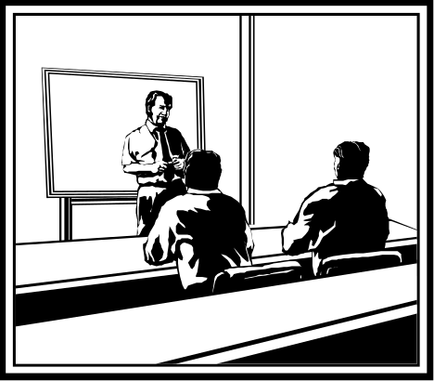
How Alliances Work
OSHA and the participating organization must define, implement and meet a set of short and long-term goals that fall into three categories:
  Training and education
  Outreach and communication
  Promote the National Dialogue on Workplace Safety and Health

Slide 37

Getting Started with Alliances
For national Alliances, contact OSHA's Office of Outreach Services and Alliances at 202-693-2340.
For regional or local Alliances, contact the OSHA regional office for your area.

Slide 38

OSHA Strategic Partnerships
The OSHA Strategic Partnership Program for Worker Safety and Health (OSPP), adopted on November 13, 1998
An expansion of OSHA's experience with voluntary programs

Slide 39
OSHA Strategic Partnerships
Extended, voluntary, cooperative relationship with groups of employers, employees, and employee representatives
Opportunity to identify a common goal, develop plans for achieving that goal, and cooperate in implementation
Most are small businesses, with an average employment of 22 workers

Slide 40
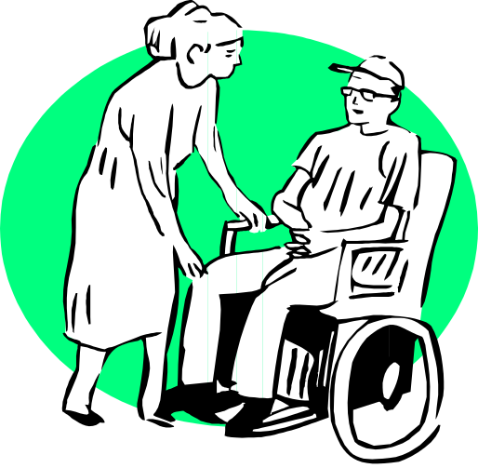
OSHA Strategic Partnerships
Many of these partnerships focus on areas of concern addressed in OSHA's Strategic Plan.
These partnerships are seeking solutions to silica and lead exposures
Serious hazards in the:
  Nursing home,
  Food processing,
  Logging, and
  Construction industries

Slide 41

Voluntary Protection Program (VPP)
Designed to recognize and promote effective safety and health management.
In the VPP, management, labor, and OSHA establish a cooperative relationship at a workplace that has implemented a strong program:
  Management program that meets OSHA criteria
  Employees participate & work with management
  OSHA provides public recognition
  Removal from routine inspections

Slide 42

Voluntary Protection Program (VPP)
VPP sites have, on average, injury rates 53 percent below their industry BLS Rates for calendar year 1999.
Studies estimate $28,000 in direct and indirect costs per every lost-workday injury!
It can be estimated that VPP sites saved more than $130,000,000 in direct and indirect costs in 1999

Slide 43
Voluntary Protection Program (VPP) - Success Stories
The longest running VPP site, a manufacturer with 600 employees, has sustained lost-workday case rates 73% below average for 15 years
Preventing 600 injuries and saving an average of more than $1 million per year in direct and indirect costs

Slide 44

Voluntary Protection Program (VPP) - Success Stories
A chemical company member with 1,000 employees kept lost-workday injury rates 93% below the average for its industry throughout its 15 years in VPP, preventing 400 injuries and saving more than $10 million

Slide 45

Voluntary Protection Program (VPP) - Success Stories
A textile mill with only one lost-workday injury since 1992 and savings of $1.4 million

Slide 46

Voluntary Protection Program (VPP) - Success Stories
The Cowtown project, which began three years ago, covers 27 Fort Worth-area sites in three high hazard industry sectors:
  Meat processing,
  Iron and steel foundries, and
  Motor vehicle manufacture
Over the first two years of the project, participants identified and corrected more than 600 hazards and experienced 420 fewer on-the-job injuries, saving more than $2 million in workers' compensation costs.

Slide 47

Voluntary Protection Program (VPP) - Success Stories
The Voluntary Protection Program continues to pay big dividends.
Today more than 500 workplaces, representing 180 industries, save $110 million each year because their injury rates are 50 percent below the average for their industries

Slide 48

OSHA's
Consultation
Service

Slide 49

OSHA Consultation Service
Free Service:
  Find out about potential hazards in the workplace
  Improve safety & health management systems
  Qualify for one-year exemption from routine inspection

Slide 50

OSHA Consultation Service
Delivered by state governments:
  Well trained staff
  On-site consultation
  Confidential
Commitment to correcting serious job hazards

Slide 51

Safety Programs
A key to
Success!

